Slide 1

An Awareness-Driven Evaluation of Identity-Based Attacks in a Zero Trust Active Directory Environment
School of Computer Science and Engineering
Department of Computer Science and Engineering
Submitted By: NAMAN JAIN
23FE10CSE00031
Supervised By: Dr. Susheela Vishnoi

Slide 2
Outline
Introduction
Literature Review
Problem Statement
Objectives
Proposed Methodology
Results
Outcome
References

Slide 3
Introduction
Active Directory in Modern Enterprises
Active Directory serves as the backbone of enterprise identity and access management.
It provides centralized authentication, authorization, and account control.
Identity-based attacks are among the most common enterprise threat vectors.
Credential compromise often enables reconnaissance and lateral movement.
AD is a high-value target in enterprise environments.

Slide 4
Introduction
Shift Towards Zero Trust Security
Modern enterprises adopt Zero Trust security principles.
Enforcement of least privilege access policies.
Policy-based hardening through Group Policy (GPO).
Host-based firewall enforcement and segmentation.
Secure-by-default configurations alter attack outcomes.

Slide 5
Literature Review
Exploitation-Focused Active Directory Studies
Many academic demos show:
Privilege escalation
Lateral movement
Domain takeover
Often assume:
Weak configurations
Disabled security controls

Slide 6
Literature Review
Identified Research Gap
Limited focus on failed attack behavior.
Insufficient evaluation of enforced security policies.
Minimal analysis of log-based detection artifacts.
Need for awareness-driven defensive evaluation.

Slide 7
Problem Statement
Modern Active Directory environments increasingly adopt Zero Trust-aligned hardening and segmentation, yet most academic demonstrations do not evaluate how identity-based attacks behave under these enforced security controls.

Slide 8
Objectives
Evaluate identity-based attack attempts in a hardened AD lab
Preserve realistic enterprise security configurations
Analyze detection through Windows Security logs
Assess impact of segmentation and policy enforcement.

Slide 9
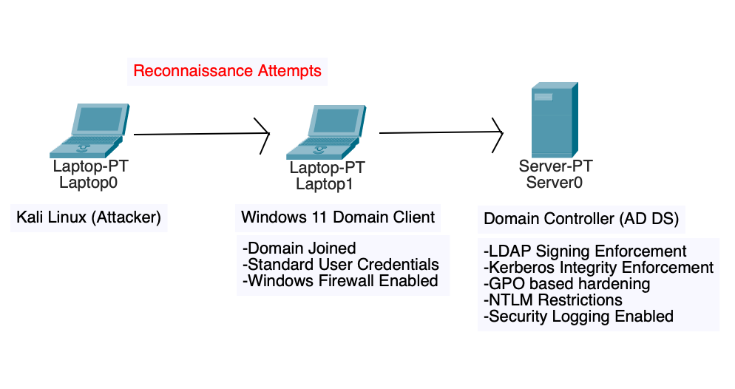
Proposed Methodology
Lab Architecture:
Windows Server Domain Controller (AD DS)
Windows 11 Domain Client
External attacker system (Kali Linux)
Controlled same-subnet lab environment.

Slide 10
Proposed Methodology
Identity & Policy Configuration
Domain setup and controller deployment
Creation of standard domain user
Client joined to domain
Low-privilege credentials used for attack simulation

Slide 11
Proposed Methodology
Hardening & Policy Enforcement
Group Policy-based security configuration
LDAP signing enforcement
Kerberos integrity enforcement
NTLM restriction policies
Windows Firewall enabled and configured

Slide 12
Proposed Methodology
Attack Simulation Approach
Reconnaissance-focused attack attempts
LDAP enumeration testing
Authentication interaction testing
Security controls remained enabled
Log monitoring during attack execution

Slide 13
Result
Attempt | Outcome | Reason
LDAP Enumeration | Blocked | LDAP signing enforced
Kerberos Interaction | Controlled, Verified | Integrity Enforcement
Lateral Access | Restricted | Firewall & segmentation
Privilege Escalation | Not achieved | Policy enforcement (Least Privilege)
Security logs generated meaningful telemetry.
Attack progression was restricted under enforced policies.

Slide 14
Outcome
Hardened Active Directory lab successfully implemented.
Identity-based attack behavior evaluated
Zero Trust-aligned controls validated
Defensive enforcement and monitoring demonstrated.

Slide 15
References
NIST SP 800-207 Zero Trust Architecture Documentation
Microsoft Active Directory Security Documentation
Research on Identity-Based Attacks in Enterprise Environments
Academic studies on AD Hardening and Detection

Slide 16
Thank You

